Slide 1
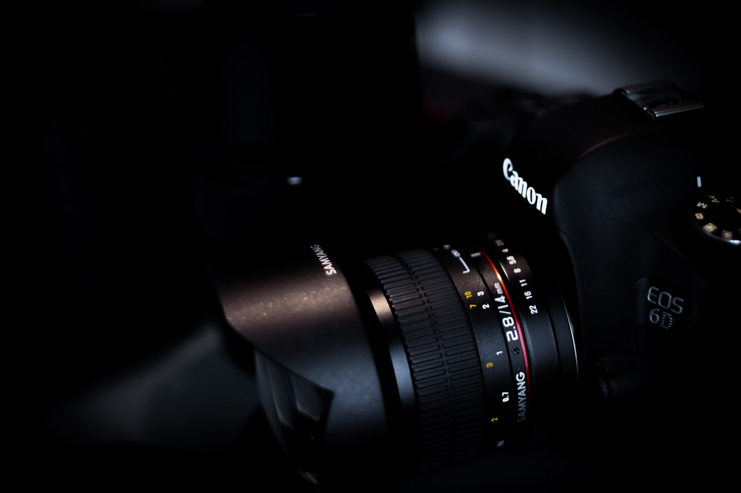
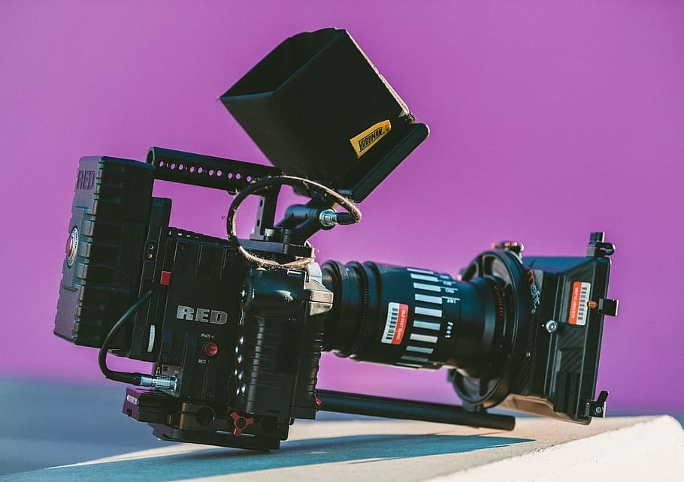
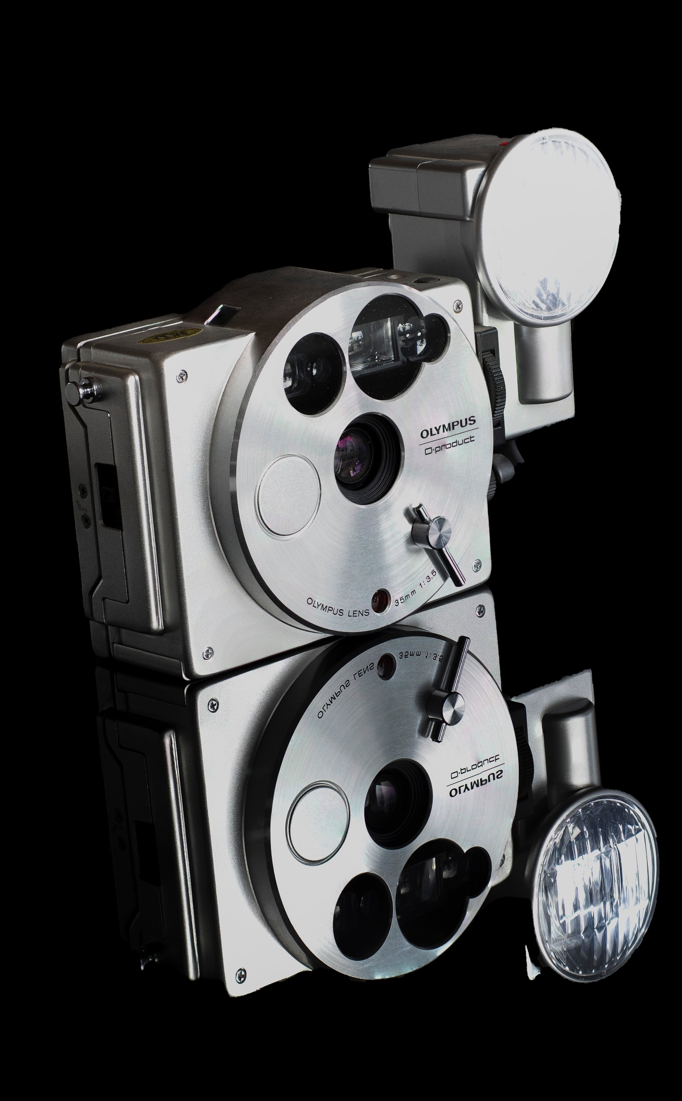
APP PHYSICS 167
APPLIED OPTICS
CAMERA CALIBRATION TOOLBOX
IMAGING OPTICS AND ELECTRONICS
NINO PHILIP RAMONES | GITHUB
2020 – 05616
SEPTEMBER 21, 2023

Slide 2
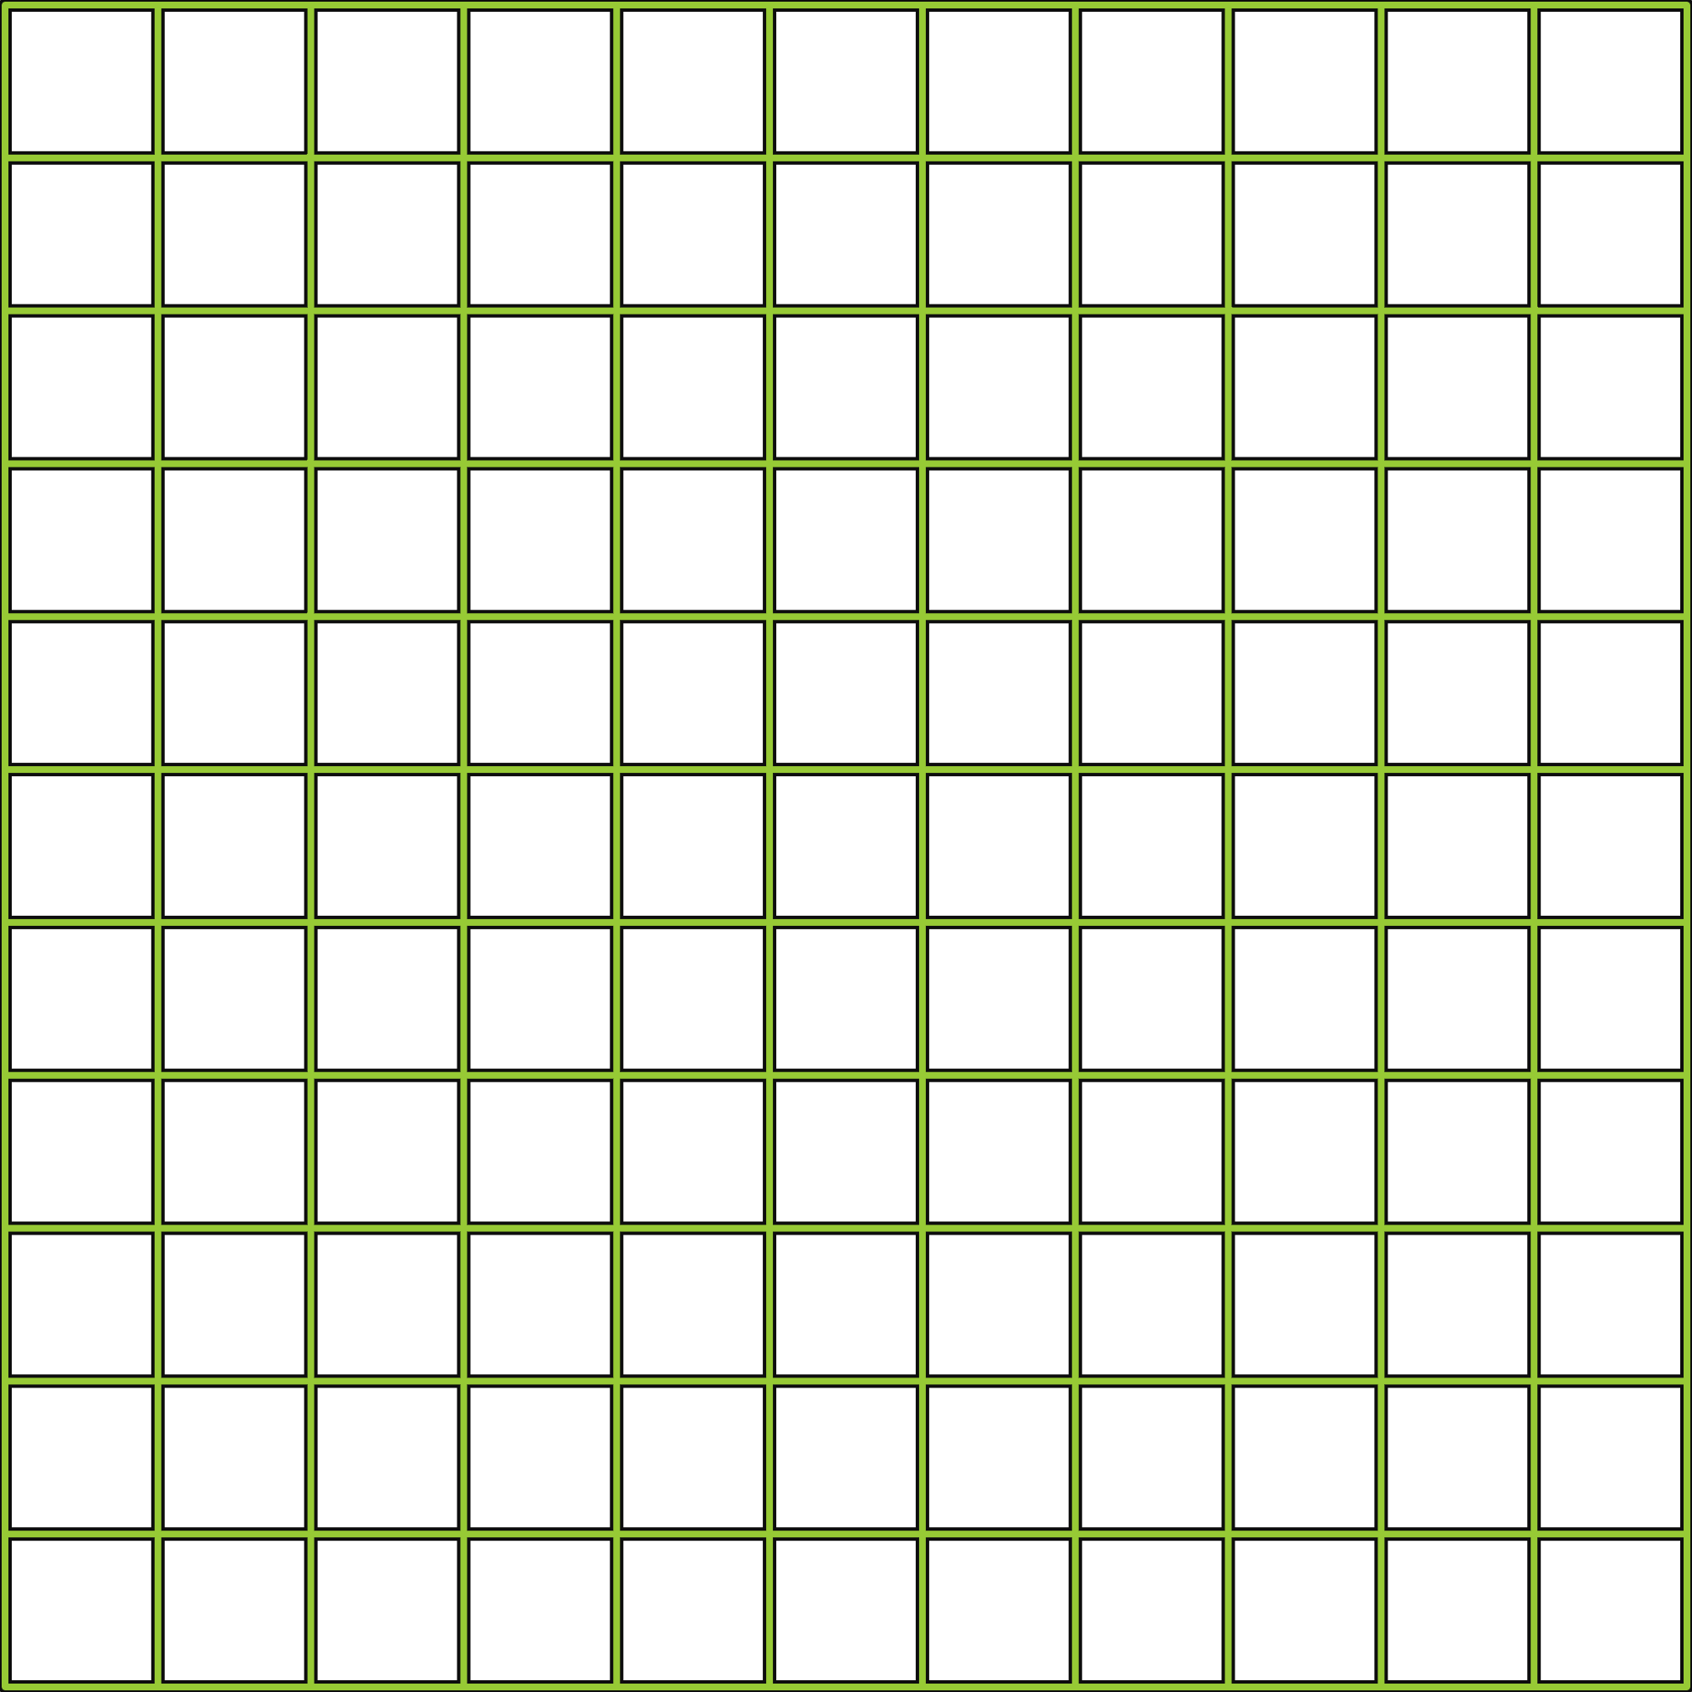
APP PHYSICS 167
CAMERA CALIBRATION
OBJECTIVES
Use the camera calibration toolbox in MATLAB to undistort the image
KEY TAKEAWAYS
Image distortion occurs when the predicted corners within the grid are far enough from the real grid corners resulting to wrong extraction of points
A first order lens distortion coefficient may be introduced to the calibration engine to make the system make a better guess of the corner locations
SOME PITFALLS
The option to enter the distortion coefficient in the recent version of MATLAB online was not available, leaving some of the sample images distorted to a certain extent

Slide 3
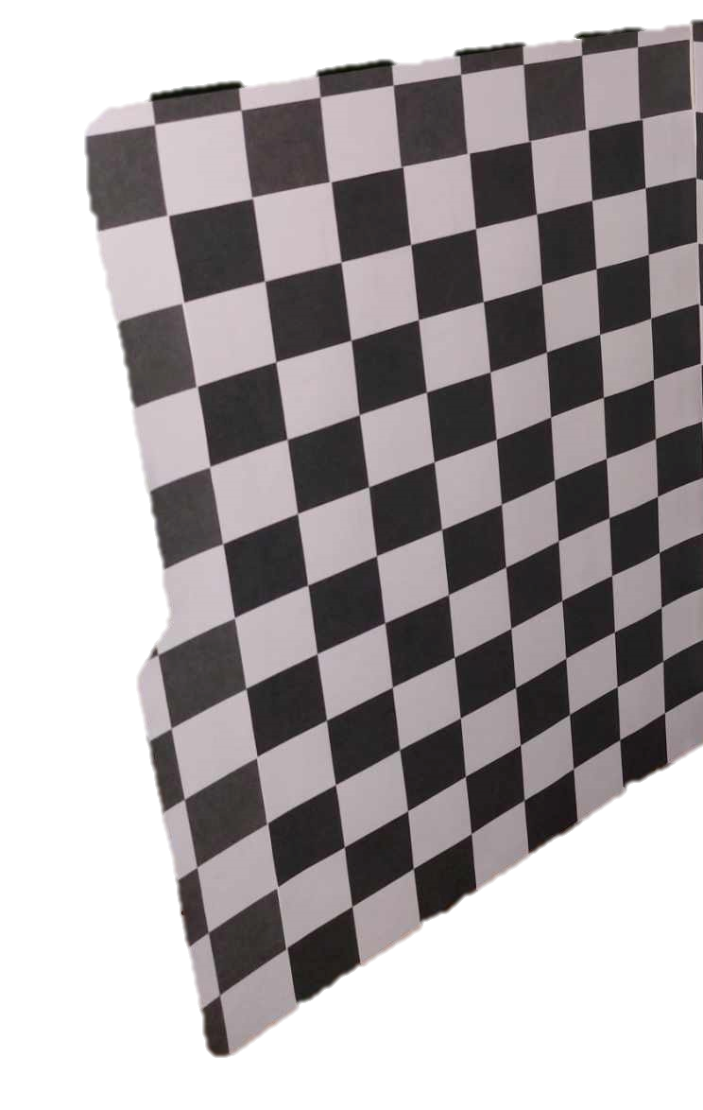
APP PHYSICS 167
CAMERA CALIBRATION
EXPERIMENTAL SETUP
The same Tsai or checkered grid was used in this activity. Only one panel was utilized upon taking sample images of the board.
Using the camera built in a Lenovo laptop, the board was positioned at different angles in contrast to the fixed position set at the previous activity. Ten photos were taken and fed into the toolbox, which will then be subjected to removal of possible image distortions using the camera calibrator toolbox in MATLAB.
The corresponding reprojections and detected points of the board were observed afterwards.
Figure 1. The Tsai grid used in the activity. The grid was used as the calibration board characterized by its uniform black and white squares of size 0.75 inches.

Slide 4
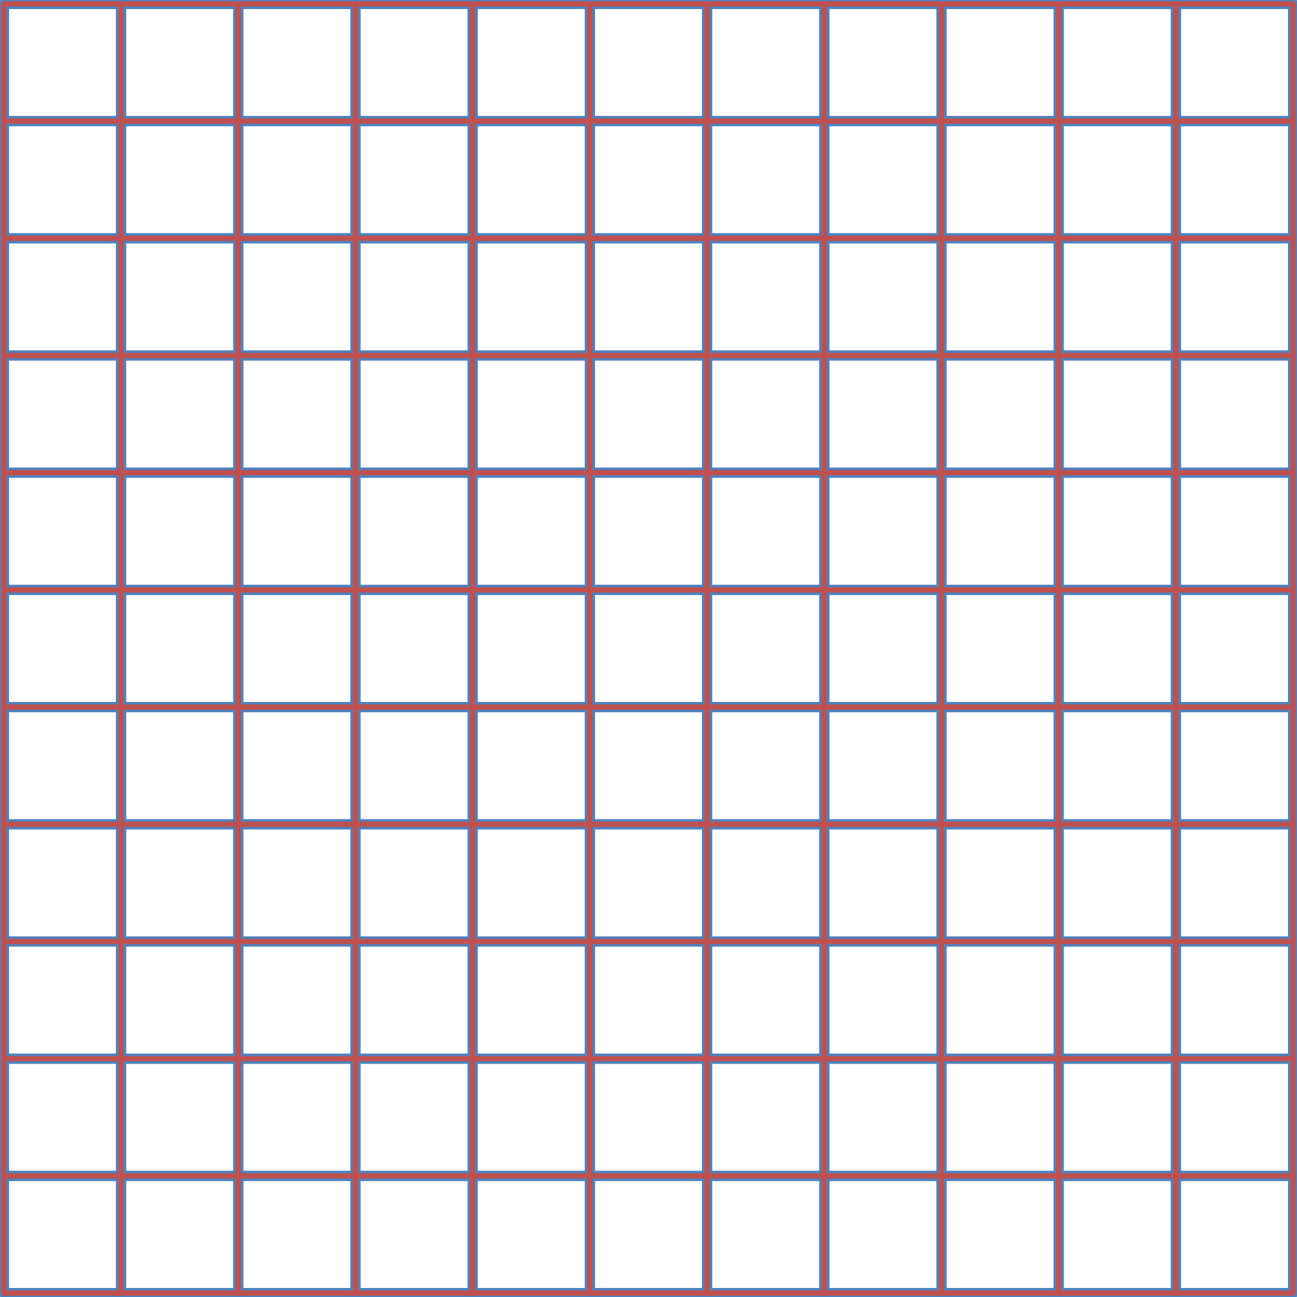
APP PHYSICS 167
CAMERA CALIBRATION
RESULTS AND DISCUSSION
Figure 2. Test images for the camera calibration. The grid was positioned at different angles as shown.

Slide 5
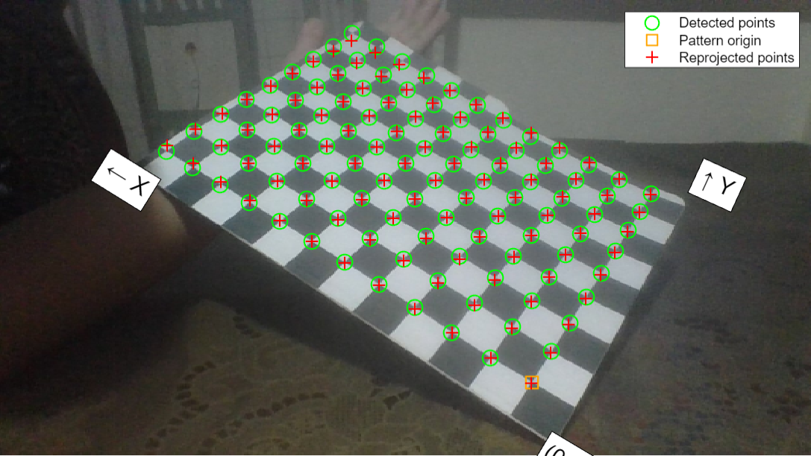
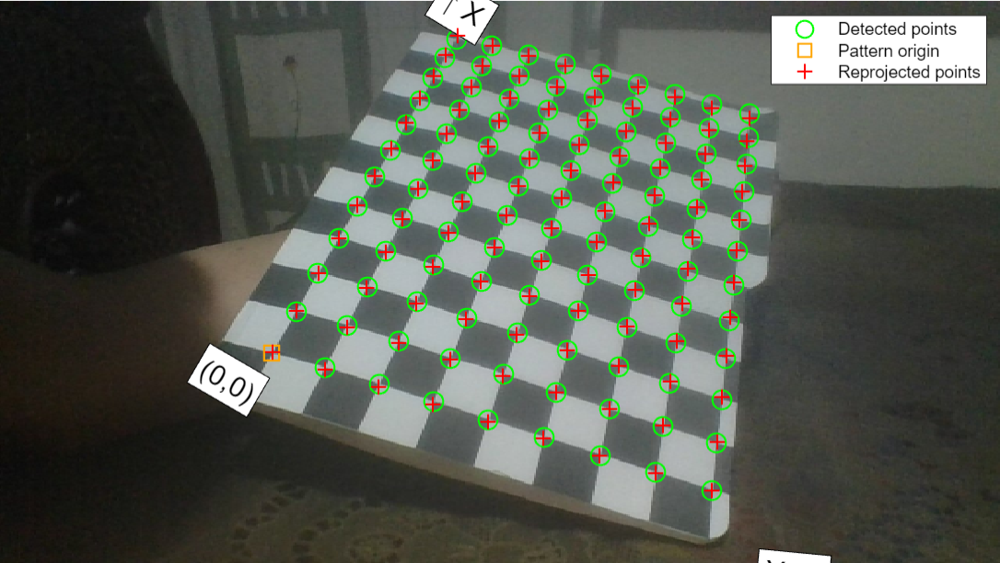
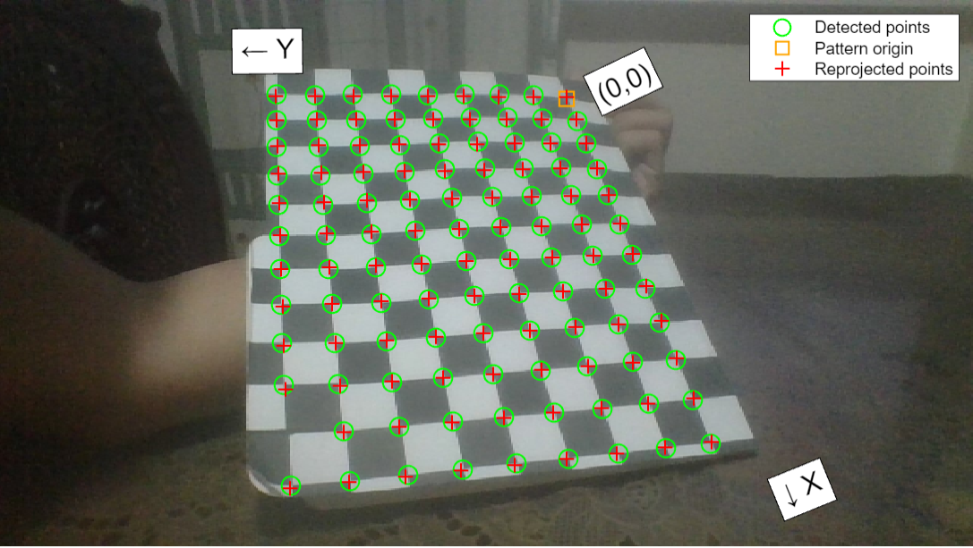
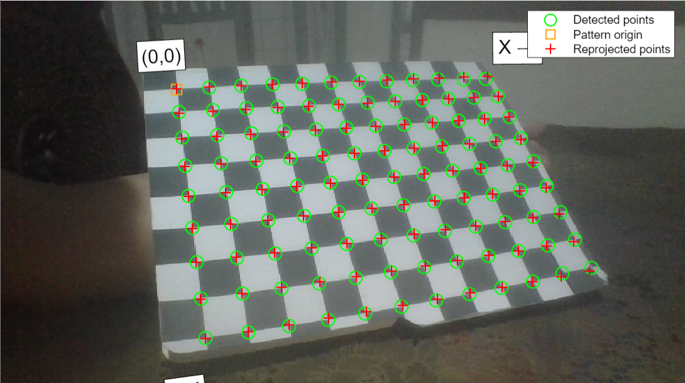
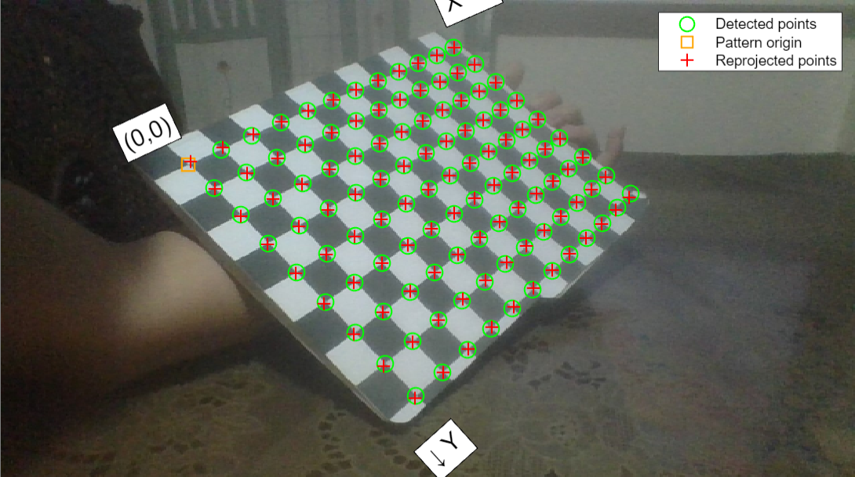
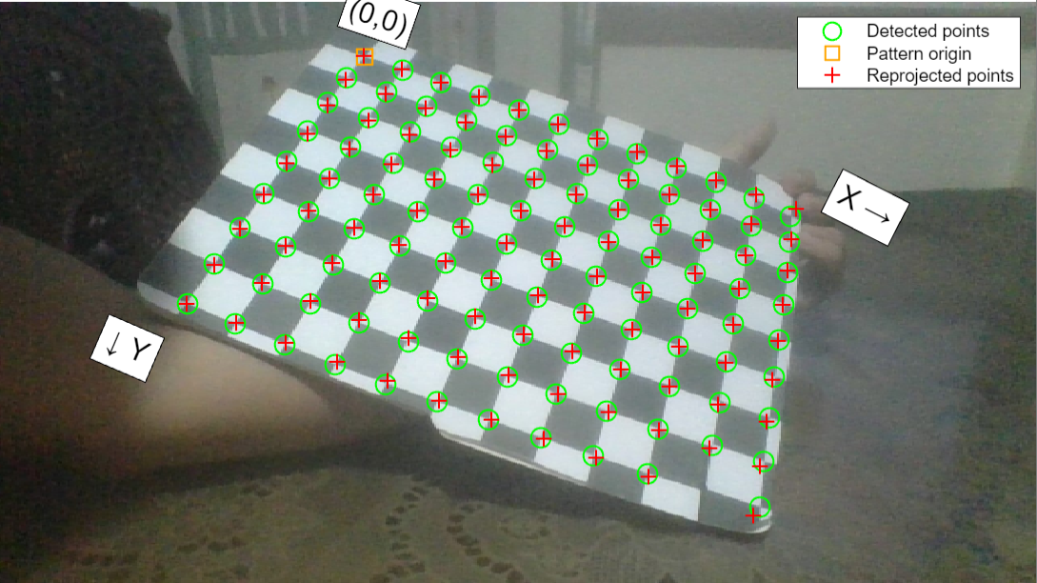
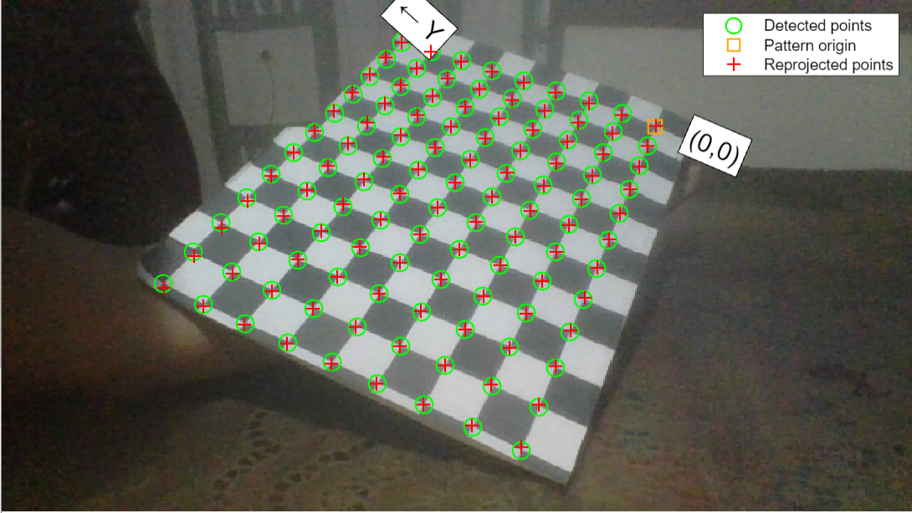
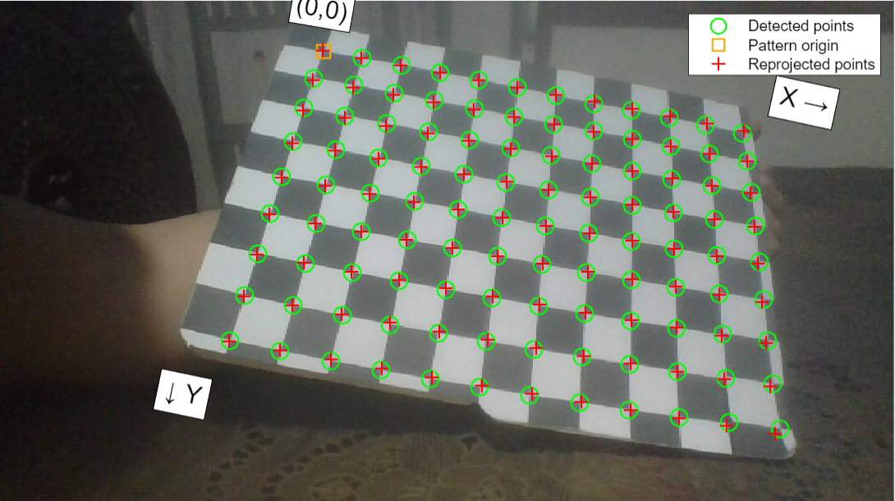
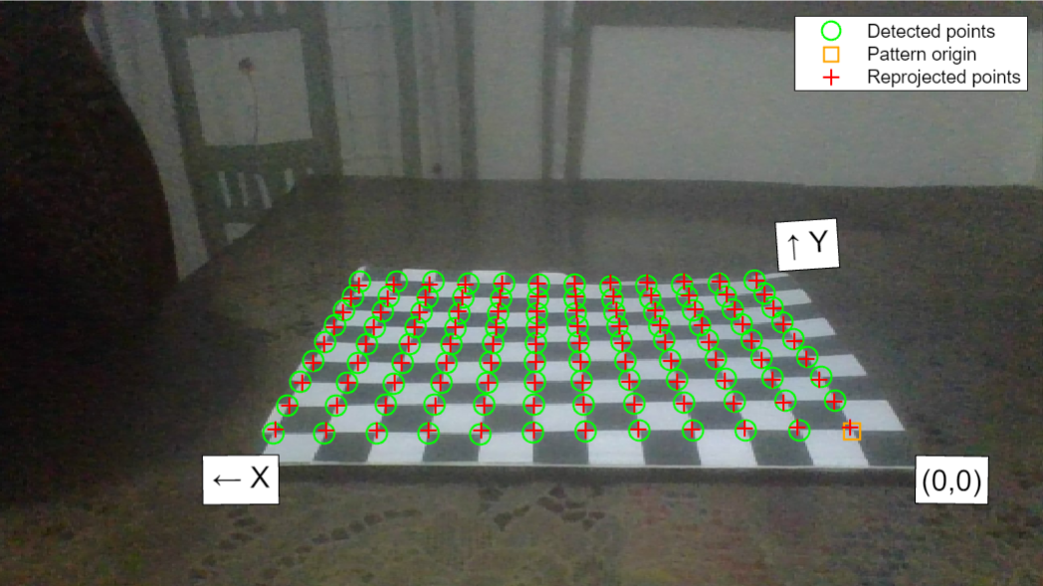
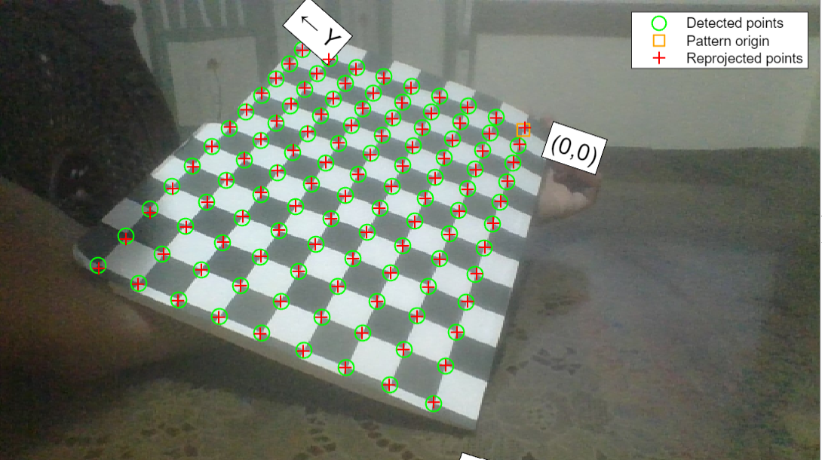
APP PHYSICS 167
CAMERA CALIBRATION
RESULTS AND DISCUSSION
Figure 3. Test images for the camera after the calibration. The grid corner points were marked in green and the reprojected points due to distortion were marked in red.

Slide 6
APP PHYSICS 167
CAMERA CALIBRATION
RESULTS AND DISCUSSIONS
Figure 4. Sample image after calibration using the camera calibration toolbox in MATLAB.
The ten images were fed into the mentioned toolbox and the calibration results were mapped in the image space by reprojecting the points within the region of the detected points of the image. The pattern origin was automatically detected by the algorithm itself. The corresponding camera parameters such as the radial and tangential distortions, and the reprojection errors were also considered for all sample images. The mean error in pixels for all images were reported to be 1.86 pixels, which is quite large since the acceptable range is less than pixel.

Slide 7
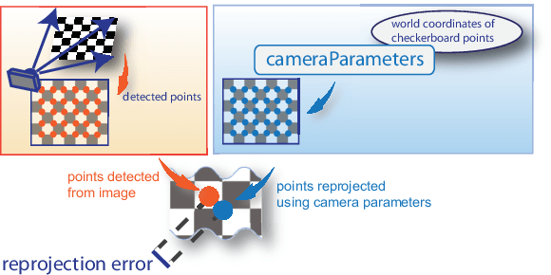
APP PHYSICS 167
CAMERA CALIBRATION
RESULTS AND DISCUSSIONS
Figure 5. Reprojection error visualization in the context of camera calibration. Image sourced from MathWorks.
One way to evaluate the calibration results from the calibration toolbox is to check the reprojection errors. In principle, reprojection errors are the distances between the detected and corresponding reprojected points on the checkboard. Using the concepts from the previous activity, this is basically the process of projecting points from world coordinates defined by the grid corners itself into image coordinates.

Slide 8
APP PHYSICS 167
CAMERA CALIBRATION
RECOMMENDATIONS
Points for improvement and considerations
Minimize reprojection errors. The mean pixel error for all the images were found to be at 1.86 pixels. These can be reduced by examining the images with high reprojection error and removing them from the sample array.
Add more samples. The previous recommendation consequently calls for adding more images since some image samples do not cover enough of the image frame. It was also observed that the calibration patterns do not have that enough variation in orientation with respect to the camera. This lack of variation in angle does not eliminate the possibility of the toolbox to have reprojection errors.
Figure 6. Some error in reprojection after calibration as pointed by the arrow on some of the grid points.

Slide 9
APP PHYSICS 167
CAMERA CALIBRATION
REFLECTION
I find the activity fun since I was able to implement the calibration using the built in toolbox in MATLAB. I think I could have done better if I inputted such distortion coefficient since some of the sample images have high reprojection errors. Nonetheless, I was able to account the points for improvement in this activity. The activity was much more straightforward compared to the previous activity since I just only have to prepare the sample images for calibration. Overall, I would give myself a score of 96/100 !
REFERENCES | GITHUB
M. Soriano, Applied Physics 167 – Geometric model for 3D imaging.
Tsai Camera Calibration (ed.ac.uk)
Using the Single Camera Calibrator App - MATLAB & Simulink (mathworks.com)
Camera Calibration Toolbox for Matlab (stanford.edu)

